Slide 1
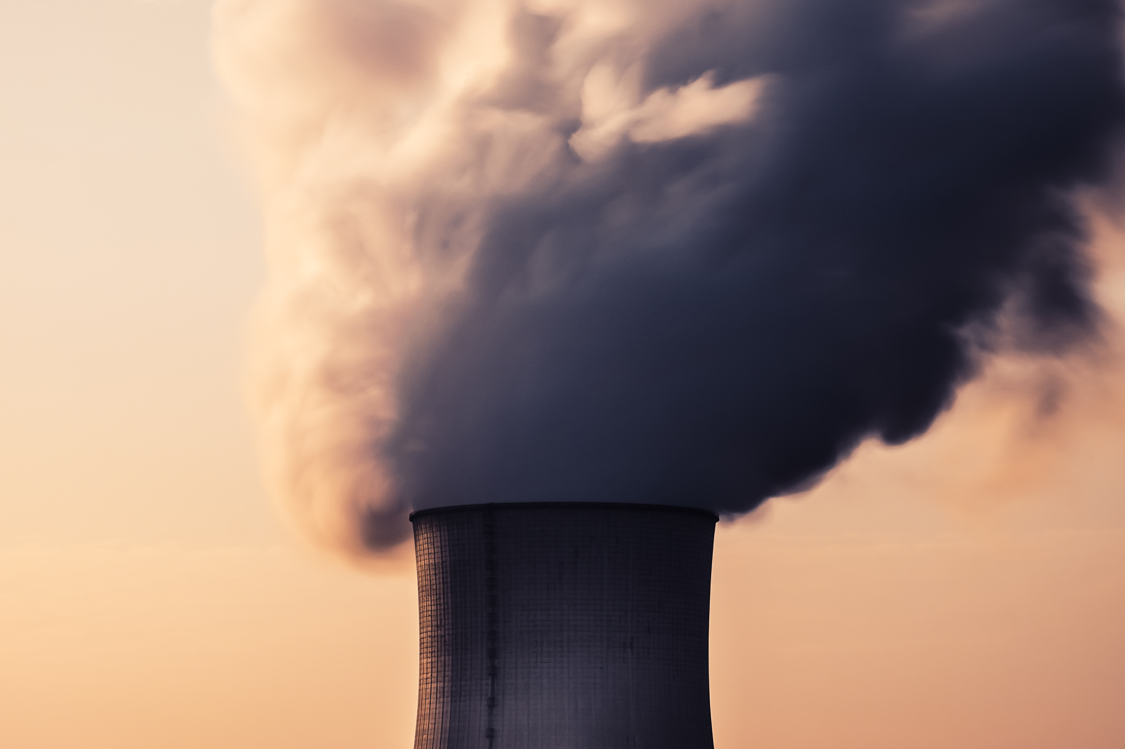
It is in the air
Team and project presentation

Slide 2
Background & CONTEXT
12% of Infant mortality
World Health Organization, data of 1997 – 2006
1% of World GDP lost to air pollution
OECD, 2060 projections

Slide 3
TARGET audience
Kindergarten or school
Can we plan outdoor trip tomorrow?
Pharmacy
Should we stock on asthma medication?
Tourist Rental Business
Bring in more workers to cope with the demand?

Slide 4


Team*
Valentin Alekseev
MSc CS, Honors from SUAI
Passion for
… Data Science
… Machine Learning
… Earth observation
… Data-driven business management

Slide 5
From Data to Decision
Data sources
Air Alert Trainer
NASA GEOS-5
Area Model
Prediction

Slide 6



Technology
Data sources
Air Alert Trainer
NASA GEOS-5
Air Alert Setup
Area Model
Prediction

Slide 7
Technology
Data: NASA GEOS-5 FP in NetCDF4 format, PM 2.5
Processing: Python 2.7, Flask
Machine Learning: Google TensorFlow, TFLearn

Slide 8
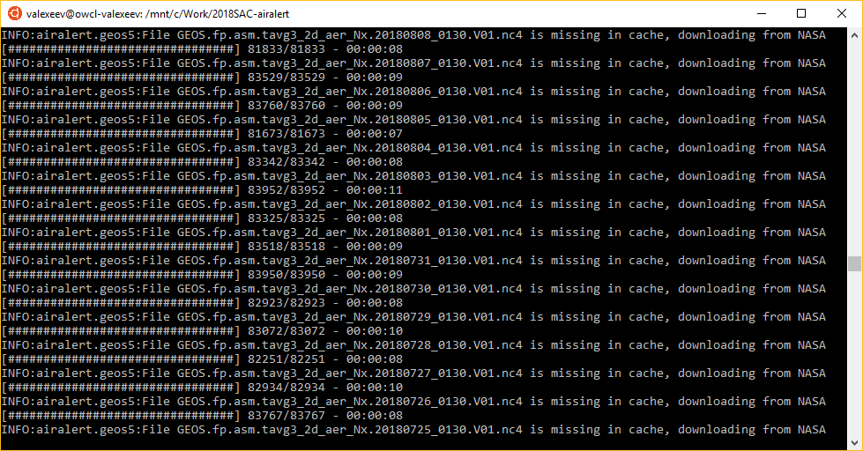
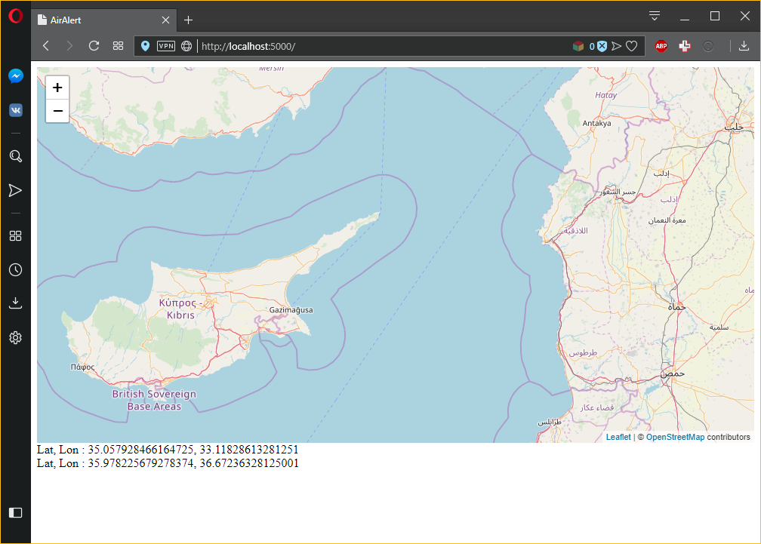
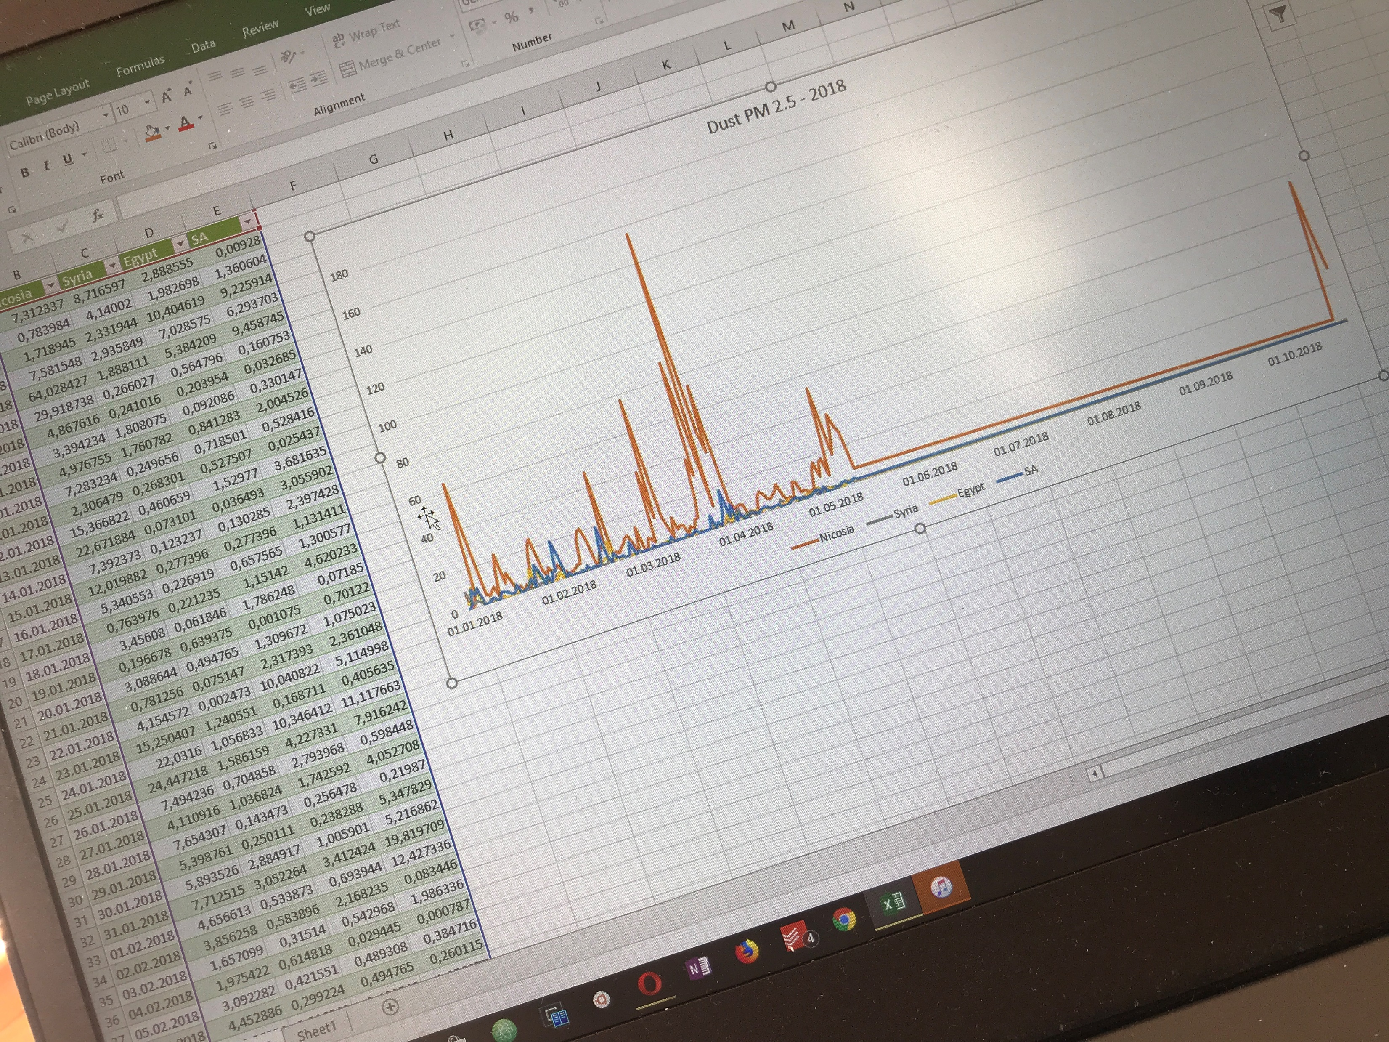
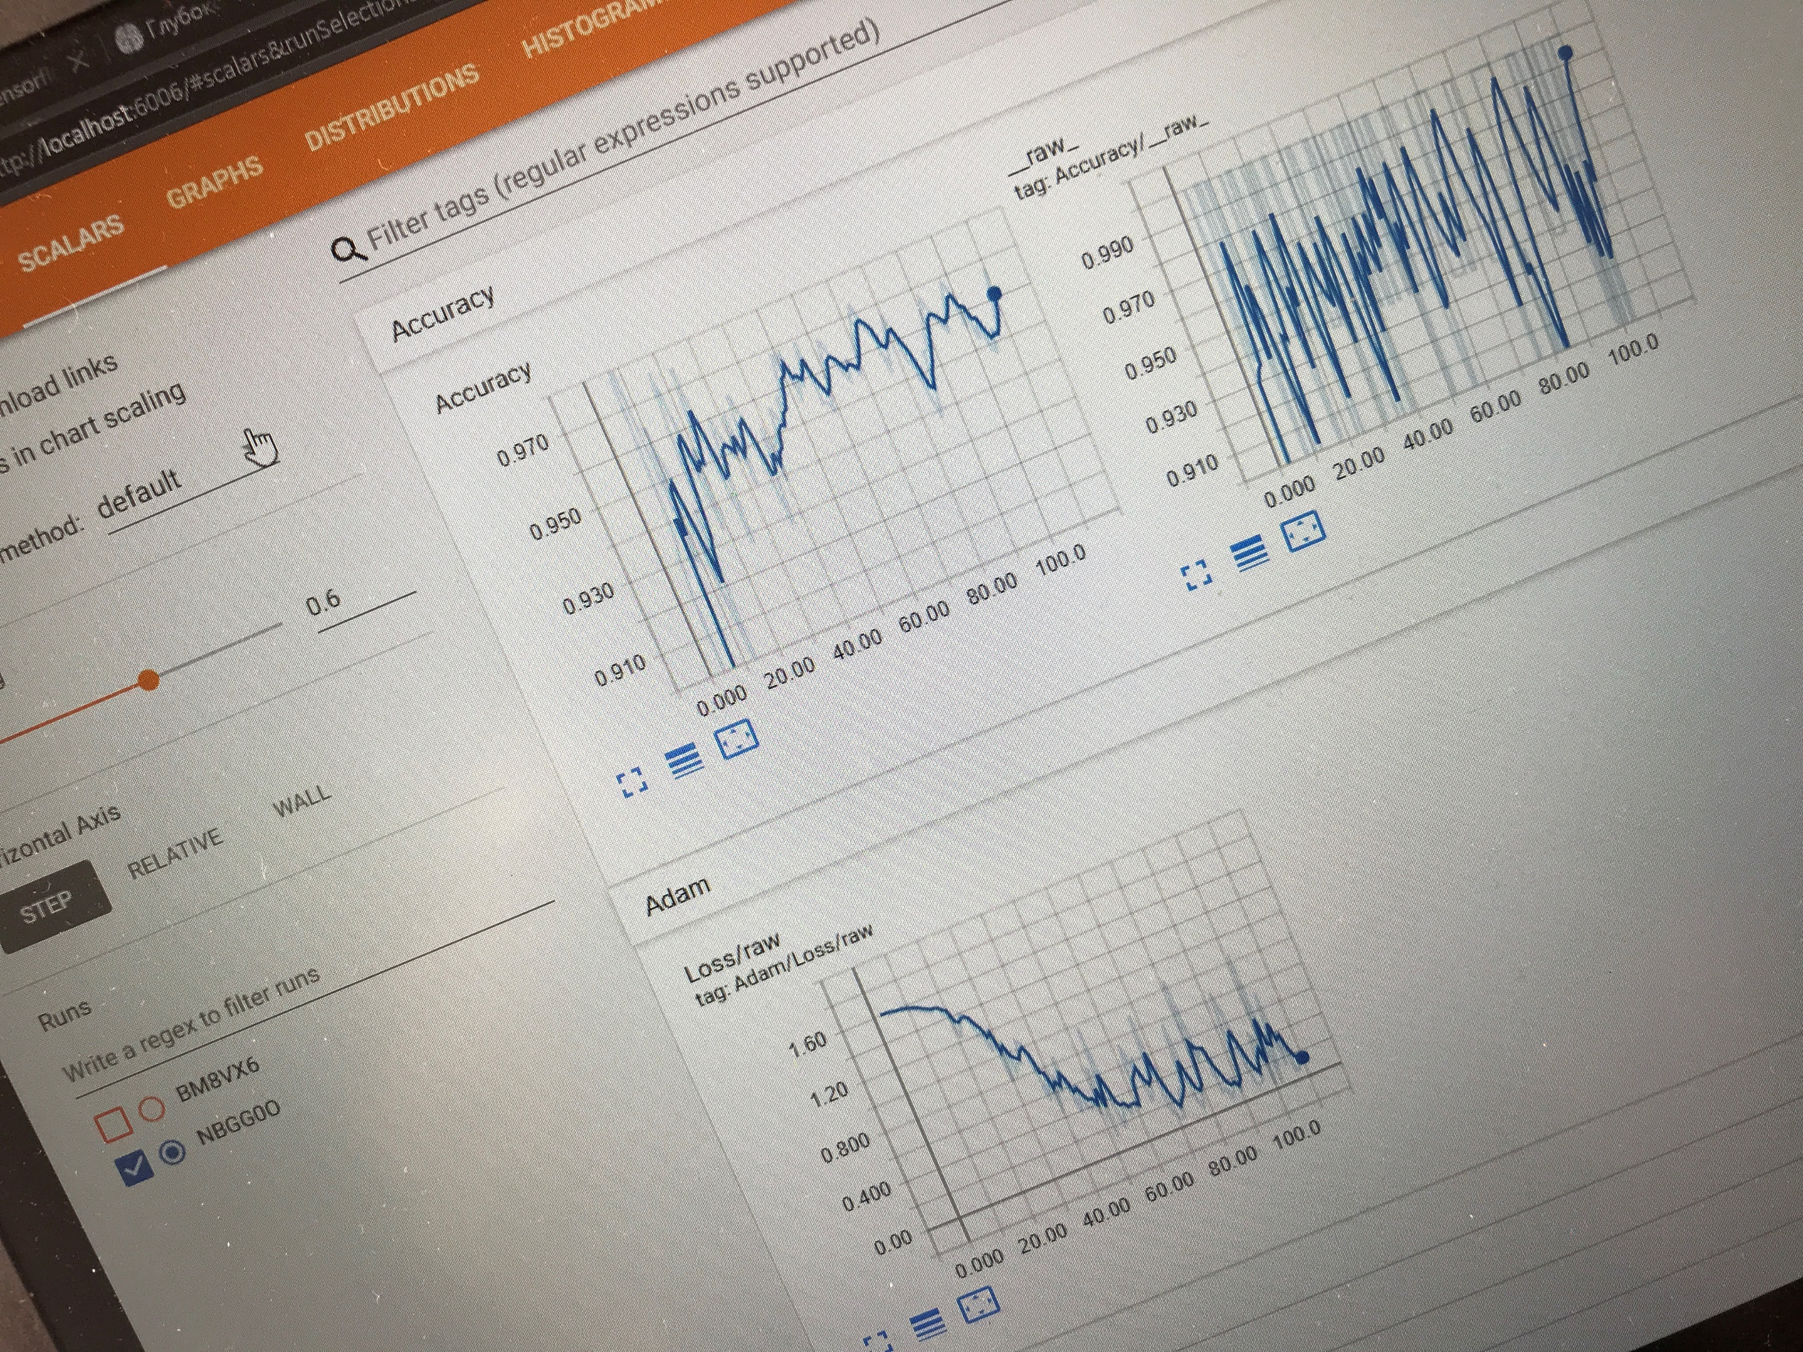
IN ACTION

Slide 9
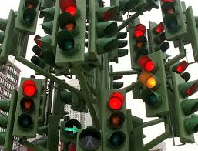
Next steps
Mobile application
Advanced push alerts
Connected devices

